Slide 1
How To a PCB Made
Presented By: Group #
Honorable faculty: Amzad Ali Sarkar Sir

Slide 2
Contents
History of the PCB.
Sequence diagram of the hole process.
Software study.
How we can draw a design.
How it’s work.
Impact in the society.
Market demand.
Advantage.
Disadvantage.
Conclusion.

Slide 3
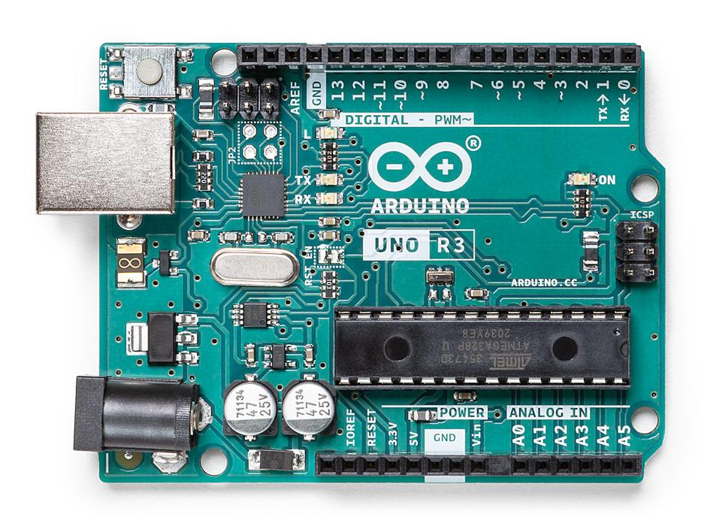
History of the PCB (Printed Circuit Board).
# Invented by Paul Eisler.
# 1st use in US military agency.
# In general the idea published in 1948.
# One of the best invention in twenty century.

Slide 4
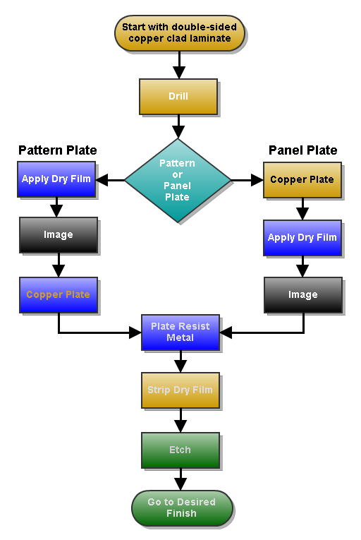
Sequence diagram of the hole process
So many process need to complete. The flowchart give us a tiny idea about the process.

Slide 5
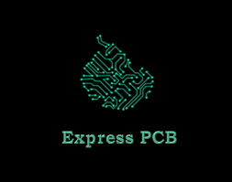

Software study
Most famous software in 2021
That we use for learn in the lab class
Fusion 360.
Altium Designer.
NI Multisim.
KiCad EDA.
Autodesk EAGLE.
EasyEDA.
DipTrace.
Ultiboard.
Express PCB
Express SCH
One of the best software for beginner.

Slide 6
How we can draw a design.
# First of all We need to make a hand diagram on a page that mainly our desire work and plan.
# Chose all the components that we need for the design and our working purpose.
# Chose the software and study all the icon that mainly helps to draw and understand the out-come.
# Take the items(Components) from dialog box we need for the drawing and place all that components in the desire position.
# Connect all the wires and make the proper PCB.
# Send a local shop or make it in the home.
# Finishing, fabrication, Drilling and Putting real components and solder them all for perfect PCB board.

Slide 7
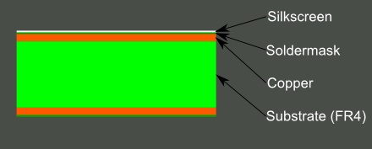
How its work
# Nowadays, most of the electronic circuit is designed on a computer. This helps electrical engineer in creating the perfect mounted arrangements parts.
# All of this process happens before making the design permanent. It is more like ink on a paper.
PCB got printed after when their design is completed.
# You can get your PCB done, online by various companies and the one, I recommend, is PCBWay. They got a professional team and delivers the order on time.
# The bottom layer is non-conductive.
# The top layer is conductive and the sheet of the top layer is made of metal such as copper.
# An ink that is printed on the metal layer is Etch-resistant ink and it is required in the design.
# Thereafter the board is covered with chemicals. It will remove the metal layer except where the design is printed.

Slide 8
Impact in the society
# Invention of electronics device is more easy in twenty century.
# Most important thinks are made by the helps of the theory.
# Devices have a small size and carriable
# Computes, Mobiles, Second-conductors industry take the important roll
# So many thinks compacted in a inch.
# PCB inspection equipment uses cameras, X-rays, and ultrasonic or UV radiation to detect defects in PCBs.

Slide 9
Market demand
In 2020, the global Printed Circuit Board (PCB) market size was USD 68480 million and it is expected to reach USD 86170 million by the end of 2027, with a CAGR of 3.3% during 2021-2027.

Slide 10
Advantage
PCBs has a low cost, mass production can be achieved at a lower cost.
It is Re-workable.
Widely available.
Excellent shelf life
This board gives low electronics noise.
Compact size and saving of wire.
Inspection time is reduced because PCBs eliminates the probability of error.
This board takes less time in assembling a circuit as compared to the conventional method.
In this design, there is no chance of loose connections or short circuit.
If in case of any damage, it is very easy to check and replace the particular failure components.

Slide 11
Disadvantage
# Uneven PCB surfaces finish.
# Not good for fine-pitch.
# It contains lead.
# Thermal shock.
# Solder bridging.
# Not easy to repair once damaged.
# It can be used for a specific circuit.
# We cannot be updated, once printed.
# Plugged or reduced.
# Redesigning is required for one type of circuit operation.
# The etching process generates chemicals which are a harmful effect on the environment.

Slide 12
Conclusion
Here we can see all the possible out comes from the PCB. Overall its can help an engineer to encourage all the perfect position and helps the user to take more benefits from the PCBs and make the day to day life's more safe, comfortable & easy. So at the end of the course we all try to continue the learning process and make ourselves as a property of the country.

Slide 13
Thank you very much for joined with us in this session.

Slide 14
Willing to know more
Contracts with us or you may visit the listed sites:
https://en.wikipedia.org/wiki/Printed_circuit_board
https://escapefromtarkov.fandom.com/wiki/Printed_circuit_board

